Slide 1
Graphics in Python using the JES environment
Guest lecture and project for CSC 8000
Fall 2011
Dr. Mary-Angela Papalaskari
Villanova University

Slide 2
Python Environment
We’ll be using JES (Jython Environment for Students).
Install the version JES 4.3 (Jython environment for students) available as free download:
http://code.google.com/p/mediacomp-jes/
CSC 8000 M.A. Papalaskari Villanova University

Slide 3
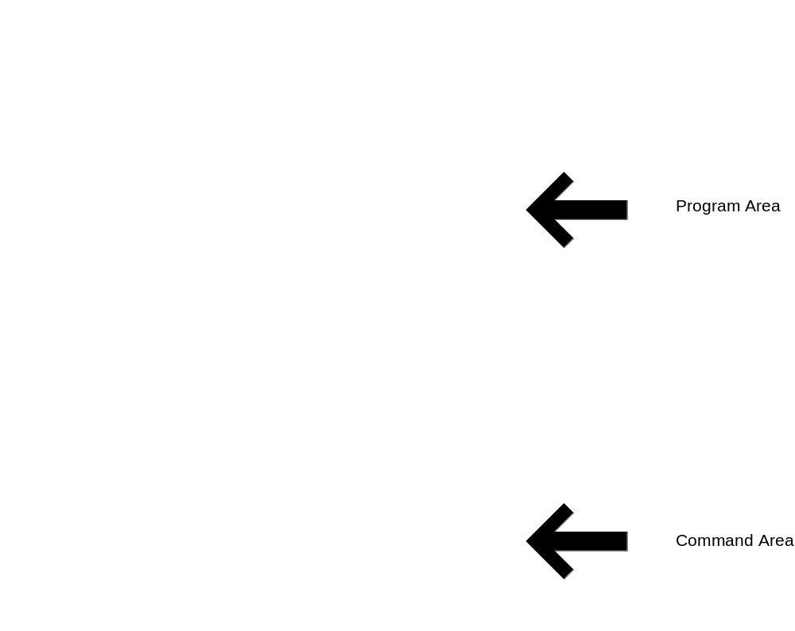
JES - Jython Environment for Students
Program area
- A simple editor for
programs
Command area
Interaction with Jython
CSC 8000 M.A. Papalaskari Villanova University

Slide 4
JES interaction through commands
Anything you type in command area is evaluated and its value is displayed
Example:
>>> 5 + 3
8
>>> ‘spam’
‘spam’
>>> “spam”
‘spam’
>>> “spam and more spam”
‘spam and more spam’
>>> ‘spam’ + ‘spam’
‘spamspam’
prompt
CSC 8000 M.A. Papalaskari Villanova University

Slide 5
Command Area Editing
Up/down arrows walk through command history
You can edit the line at the bottom
  Just put the cursor at the end of the line before hitting Return/Enter.
CSC 8000 M.A. Papalaskari Villanova University

Slide 6
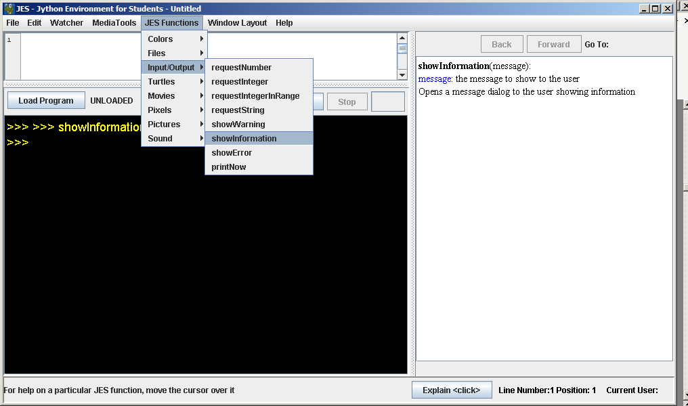
Special JES-Python functions
JES defines some special functions for media computation
CSC 8000 M.A. Papalaskari Villanova University

Slide 7
Example: showInformation()
showInformation(message):
message: the message to show to the user
Opens a message dialog to the user showing information
message
showInformation(message)
Pops up a new window
displaying the message text
CSC 8000 M.A. Papalaskari Villanova University

Slide 8
Example: requestNumber()
“What is the answer
to Life, the Universe
and Everything?”
requestNumber(“What is the answer to Life,
the Universe
and Everything?” )
Pops up a new window
displaying the message text
with an input box where the user
can type in a number, e.g., 42
42
CSC 8000 M.A. Papalaskari Villanova University

Slide 9
Example: makeEmptyPicture()
300
200
makeEmptyPicture(300,200)
300 x 200 blank image
makePicture(width,height)
creates and returns a picture object of the given dimensions
CSC 8000 M.A. Papalaskari Villanova University

Slide 10
Example: show()
picture-object
(an encoding of an image)
show(picture-object)
Pops up a new window
displaying image stored
in picture-object
CSC 8000 M.A. Papalaskari Villanova University

Slide 11
Example: pickAFile()
pickAFile()
Pops up a dialog
box for the user to
select a file
Filename
(eg: C:\Documents and Settings\mpapalas\My Documents\greenroom.jpg)
CSC 8000 M.A. Papalaskari Villanova University

Slide 12
Example: makePicture()
theFile (a string containing a file name)
makePicture(filename)
Picture object corresponding to
image that is saved in theFile
makePicture(filename)
creates and returns a picture object, from the JPEG file at the filename
CSC 8000 M.A. Papalaskari Villanova University

Slide 13
Examples: Manipulating Pictures
makeEmptyPicture(width,height) creates a new empty picture
show(picture) displays a picture in a separate window
  >>> pic1 = makeEmptyPicture(200,100)
  >>> show(pic1)
  >>> setAllPixelsToAColor(pic1, red)
  >>> show(pic1)
  >>> addText(pic1,30,50,“hello")
similarly can add rectangles, lines, etc.
CSC 8000 M.A. Papalaskari Villanova University

Slide 14
Demonstrating picture manipulation with JES
>>>
>>> pic1 = makeEmptyPicture(200,100)
>>> show(pic1)
>>> setAllPixelsToAColor(pic1, red)
>>> show(pic1)
>>> addText(pic1,30,50,“hello")
CSC 8000 M.A. Papalaskari Villanova University

Slide 15
Demonstrating picture manipulation with JES
>>>
>>> print pickAFile()
C:\Documents and Settings\mpapalas\Desktop\sample.jpg
>>> theFile = "C:\Documents and Settings\mpapalas\Desktop\sample.jpg"
>>> makePicture(theFile)
Picture, filename C:\Documents and Settings\mpapalas\Desktop\sample.jpg height 1200 width 1600
>>> print makePicture(theFile)
Picture, filename C:\Documents and Settings\mpapalas\Desktop\sample.jpg height 1200 width 1600
>>> pic = makePicture(theFile)
>>> print pic
Picture, filename C:\Documents and Settings\mpapalas\Desktop\sample.jpg height 1200 width 1600
>>> show(pic)
CSC 8000 M.A. Papalaskari Villanova University

Slide 16
Common errors
>>> file = pickAFile()
>>> pic = makePicture(file)
>>> show(file)
The error was:sample
Name not found globally.
A local or global name could not be found. You need to define the function or variable before you try to use it in any way.
>>> show(pic)
>>> print pic
Picture, filename C:\Documents and Settings\mpapalas\Desktop\sample.jpg height 1200 width 1600
Oops!
CSC 8000 M.A. Papalaskari Villanova University

Slide 17
A function for displaying picked picture files:
pickAFile()
Pops up a dialog
box for the user to
select a file
theFile
makePicture(filename)
pickAndShow()
def pickAndShow():
theFile = pickAFile()
pic = makePicture(theFile)
show(pic)
pic
show(picture-obj)
Pops up a new window
displaying image stored
in the the picture object
CSC 8000 M.A. Papalaskari Villanova University

Slide 18
A function for playing picked sound files
def pickAndPlay():
myfile = pickAFile()
mysound = makeSound(myfile)
play(mysound)
CSC 8000 M.A. Papalaskari Villanova University

Slide 19
Anything complicated is best done in the Program Area
Program area
- A simple editor for
programs
Command area
Interaction with Jython
CSC 8000 M.A. Papalaskari Villanova University

Slide 20
Exploring more functions
The JES Functions menu has functions arranged by type - check them out!
Can you find a function that saves a file?
Can you find under what category pickAFile() is listed?
CSC 8000 M.A. Papalaskari Villanova University

Slide 21
Exercise
Create a function that…
  Causes an interactive input window to pop up and request some form of input from the user and stores it in a variable
  Displays the value stored in the variable
  Displays an image
Save your function in a file
Load it
Use the function in the command area to make sure that it works and does what you want it to do
CSC 8000 M.A. Papalaskari Villanova University

Slide 22
More Picture Functions
makePicture(filename) creates and returns a picture object, from the .JPG or .PNG file at the filename
We’ll learn functions for manipulating pictures later, like getColor(), setColor(), and repaint()
CSC 8000 M.A. Papalaskari Villanova University

Slide 23
Making new Colors
Some names for common colors are predefined – try using the names: yellow, black, white, etc.
makeColor() takes red, green, and blue values (in that order) between 0 and 255, and returns a Color object
pickAColor() lets you use a color chooser and returns the chosen color
CSC 8000 M.A. Papalaskari Villanova University

Slide 24
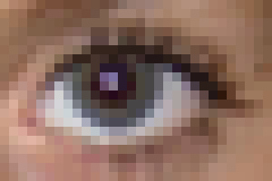
red=108
green=86
blue=142
y = 9
Color:(108,86,142)
Position: (12,9)
x = 12
CSC 8000 M.A. Papalaskari Villanova University

Slide 25
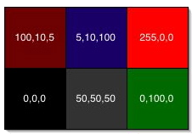
Encoding RGB
Colors go from
(0,0,0) to (255,255,255)
>>> pic2 = makeEmptyPicture(200,100)
>>> show(pic2)
>>> seafoam = makeColor(153, 255, 204)
>>> setAllPixelsToAColor(pic2, seafoam)
>>> show(pic2)
CSC 8000 M.A. Papalaskari Villanova University

Slide 26
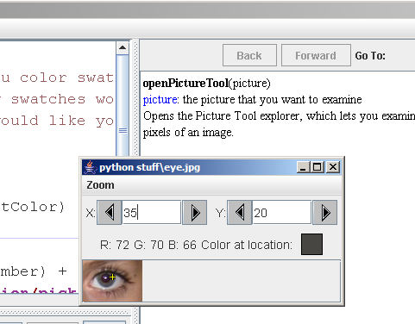
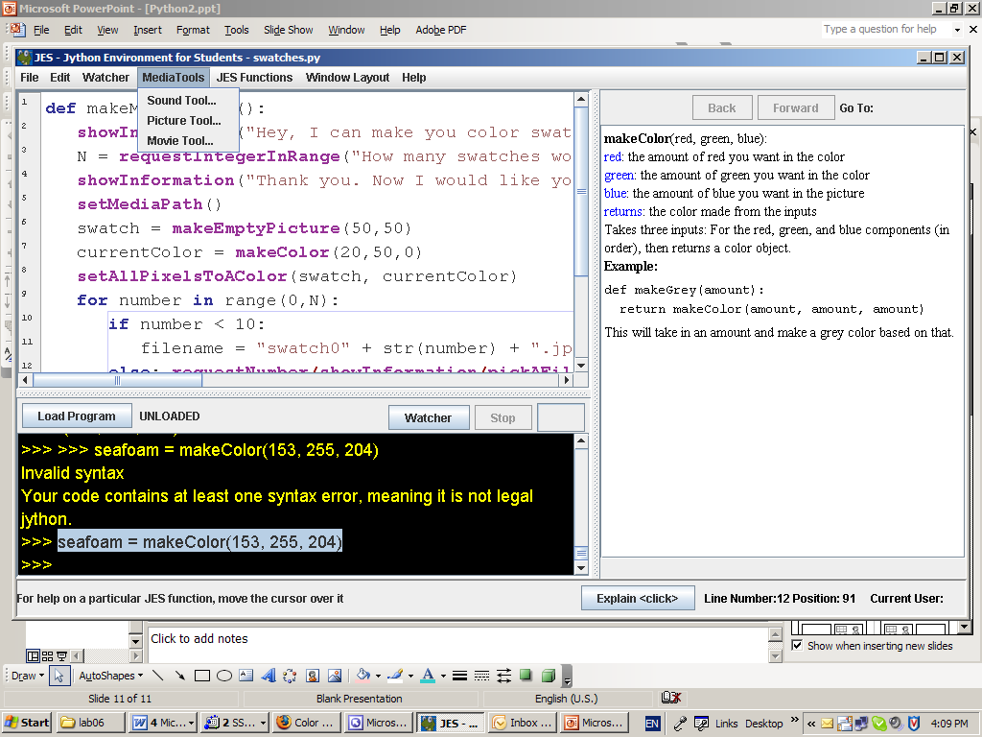
Media Tools
How do you find out what RGB values you have? And where?
JES Picture function
OR
Media Tools menu
CSC 8000 M.A. Papalaskari Villanova University

Slide 27
Saving to a file
setMediaPath():
Prompts the user to pick a folder on the computer. JES then will look for files in that directory unless given a full path, i.e. one that starts with "c:\"
writePictureTo(picture, path):
picture: the picture you want to be written out to a file
path: the path to the file you want the picture written to
Takes a picture and a file name (string) as input, then writes the picture to the file as a JPEG.
Example:
>>> setMediaPath()
writePictureTo(pic, “mypic.jpg”)
CSC 8000 M.A. Papalaskari Villanova University

Slide 28
Conditionals
if age < 18:
showInformation(“Sorry, not allowed to vote yet.”)
else:
showInformation(“Please select candidate.”)
CSC 8000 M.A. Papalaskari Villanova University

Slide 29
Repetition
for number in range(0,N):
pic = ....
filename = base + str(number)
writePictureTo(pic, filename)
CSC 8000 M.A. Papalaskari Villanova University

Slide 30
Lists
[“hi”, “hello”, “howdy”, “hiya”, “yo”]
[10, 23, 15]
[]
range(0,6)
range(1,4)
range(3,8)
CSC 8000 M.A. Papalaskari Villanova University

Slide 31
Exercise
Create a function makeMeSwatches() that makes lots of color swatches (small solid-colored image files). Specifically, your function should:
display a welcome message to the user
ask the user to say how many swatches
ask the user to select a folder for storing the swatches
create small files with images of solid color save each one in the selected folder with names "swatch0.jpg", "swatch1.jpg", "swatch2.jpg", etc
display a message letting the user know that it is finished.
CSC 8000 M.A. Papalaskari Villanova University

Slide 32
Getting at the pixels
getPixel(picture,x,y)
  Gets a single pixel – returns pixel at position x,y of picture
getPixels(picture)
  gets all the pixels – returns an array containing all the pixels of picture
CSC 8000 M.A. Papalaskari Villanova University

Slide 33
red=108
green=86
blue=142
y = 9
Color:(108,86,142)
Position: (12,9)
x = 12
>>> p = getPixel(picture,12,9)
>>> print p
Pixel, red=108 green=86 blue=142
CSC 8000 M.A. Papalaskari Villanova University

Slide 34
What can we do with a pixel p?
getRed(p),
getGreen(p)
getBlue(p)
setRed(p, value)
setGreen(p, value)
setBlue(p, value)
functions that take a pixel (p) as input and return a value between 0 and 255
functions that set the value of pixel (p) to a given value between 0 and 255
CSC 8000 M.A. Papalaskari Villanova University

Slide 35
We can also get, set, and modify Colors
getColor(p) takes a pixel as input and returns a Color object with the color at that pixel
setColor(p, c) sets the color of pixel (p) as input and a color (c), then sets the pixel to that color.
We also have functions that can makeLighter(c) and makeDarker(c) an input color
Last time we saw that we can also create colors:
  makeColor(r,g,b) takes red, green, and blue values (in that order) between 0 and 255, and returns a Color object
  pickAColor() lets you use a color chooser and returns the chosen color
CSC 8000 M.A. Papalaskari Villanova University

Slide 36
red=108
green=86
blue=142
y = 9
Color:(108,86,142)
Position: (12,9)
x = 12
>>> pixel=getPixel(picture,12,9)
>>> print pixel
Pixel, red=108 green=86 blue=142
>>> value = getRed(pixel)
>>> setRed (pixel, value+50)
>>> setGreen(pixel, 0)
>>> setBlue(pixel, getBlue(pixel)/2)
CSC 8000 M.A. Papalaskari Villanova University

Slide 37
red=108
red=158
green=86
Green=0
blue=142
Blue=121
y = 9
y = 9
Color:(108,86,142)
Position: (12,9)
Color:(158,0,121)
Position: (12,9)
x = 12
>>> pixel=getPixel(picture,12,9)
>>> print pixel
Pixel, red=108 green=86 blue=142
>>> value = getRed(pixel)
>>> setRed (pixel, value+50)
>>> setGreen(pixel, 0)
>>> setBlue(pixel, getBlue(pixel)/2)
CSC 8000 M.A. Papalaskari Villanova University

Slide 38
red=108
green=86
blue=142
y = 9
Color:(108,86,142)
Position: (12,9)
x = 12
>>> pixel=getPixel(picture,12,9)
>>> print pixel
Pixel, red=108 green=86 blue=142
>>> redValue = getRed(pixel)
>>> greenValue = getGreen(pixel)
>>> blueValue = getBlue(pixel)
>>> newColor = makeColor(redValue+50, 0, getBlue(pixel)/2)
>>> setColor(pixel, newColor)
CSC 8000 M.A. Papalaskari Villanova University

Slide 39
red=158
Green=0
Blue=121
y = 9
Color:(158,0,121)
Position: (12,9)
x = 12
>>> pixel=getPixel(picture,12,9)
>>> print pixel
Pixel, red=108 green=86 blue=142
>>> redValue = getRed(pixel)
>>> greenValue = getGreen(pixel)
>>> blueValue = getBlue(pixel)
>>> newColor = makeColor(redValue+50, 0, getBlue(pixel)/2)
>>> setColor(pixel, newColor)
CSC 8000 M.A. Papalaskari Villanova University

Slide 40
Repeating an action for all the pixels in a picture
Example:
for p in getPixels(picture):
value = getRed(p)
setRed(p, value*0.5)
CSC 8000 M.A. Papalaskari Villanova University

Slide 41
Repeating an action for all the pixels in a picture decreaseRed()
Example:
def decreaseRed(picture):
for p in getPixels(picture):
value = getRed(p)
setRed(p, value*0.5)
CSC 8000 M.A. Papalaskari Villanova University

Slide 42
More examples:
More examples (link) - you can copy and paste these to save time
decreaseGreen()
decreaseBlue()
clearBlue()
lighten()
darken()
negative()
grayScale()
CSC 8000 M.A. Papalaskari Villanova University

Slide 43
Menu driven program – create your very own baby photoshop!
Create a menu-driven picture manipulation function that allows the user to make various changes to images. Here is the algorithm:
welcome the user to your program
get the user to select a picture to work on
show(picture)
ask the user select one of the following options:
  Make picture grayscale
  Decrease red by 10%
  Decrease green by 10%
  Decrease blue by 10%
  “Posterize” (see below)
  <at least one more feature, of your choice>
repaint(picture)
ask user whether to save the new picture, and if the response is “y”, save it
show goodbye/thank you message
Links to small images you can use to test your program: eye.jpg, luca.jpg
CSC 8000 M.A. Papalaskari Villanova University

Slide 44


“Posterize” function
For each pixel, if red<128, we set red=0, otherwise we set red=255
Similarly for green, blue
CSC 8000 M.A. Papalaskari Villanova University

Slide 45
Long sets of instructions…
Example:
requestIntegerInRange(“Please enter one of the following
…
requestIntegerInRange(“Please enter one of the following options: 1) grayscale, 2) reduce red,
…
requestIntegerInRange(“Please enter one of the following options: 1) grayscale, 2) reduce red, 3) reduce green, 4) reduce blue, 5) posterize”)
…
Need to break across lines – insert “new line” as part of the message.
\n
CSC 8000 M.A. Papalaskari Villanova University

Slide 46
Escape characters
Special characters that cannot be used directly as part of a string, eg:
\n – new line
\t – tab
\\ – backslash (\)
\’ – single quote
Example:
showInformation(“see you\nlater”)
CSC 8000 M.A. Papalaskari Villanova University

Slide 47
Steganography
The knowledge that a secret exists is half of the secret -- Joshua Meyrowitz
From the Greek words στεγανός and γράφω meaning “covered writing.”
Art and Science of hiding information in ways that prevent detection.
Can be used on audio, text, packet headers, or images
Similar to Cryptography –Cryptography: scrambles message –Steganography: hides message
CSC 8000 M.A. Papalaskari Villanova University

Slide 48
Hiding a picture within a picture
Least Significant Bit (LSB)
One of most common techniques
Alters LSB of each pixel (1 bit out of 24 --or 1 out of 8 for grayscale)
Uses the concept of parity, ie, even numbers in binary end in 0, odd ones end in 1
Easiest to implement: hiding bitmaps in a color picture
Hiding ASCII code, one letter at a time
CSC 8000 M.A. Papalaskari Villanova University

Slide 49
Example
To hide letter C (1000011) in a grayscale file:
Original:
01001101 01001110 01001110 01001111 01010000 01010000 01001111
1 0 0 0 0 1 1
Encoded:
01001101 01001110 01001110 01001110 01010000 01010001 01001111
CSC 8000 M.A. Papalaskari Villanova University

Slide 50
Steganography- Encoding example
def encode(picture, message):
import java.awt.Font as Font
myFont = makeStyle("Arial", Font.BOLD, 24)
msgPicture = makeEmptyPicture(getWidth(picture), getHeight(picture), white)
addTextWithStyle(msgPicture,10,28,message, myFont, black)
encodePicture(picture, msgPicture)
def encodePicture(picture, msgPicture):
for pxl in getPixels(picture):
if (getRed(pxl) % 2) == 1:
setRed(pxl, getRed(pxl) - 1)
for x in range(0, getWidth(picture)):
for y in range(0, getHeight(picture)):
msgPxl = getPixel(msgPicture, x, y)
origPxl = getPixel(picture, x, y)
if distance(getColor(msgPxl), black) < 100.0:
setRed(origPxl, getRed(origPxl)+1)
CSC 8000 M.A. Papalaskari Villanova University

Slide 51
Steganography- decoding
Need to determine which pixels have been changed.
No need to have original image – the rightmost bit of the image with the code does not depend on the original
We can thus loop through the pixels and reconstruct the message image
CSC 8000 M.A. Papalaskari Villanova University

Slide 52
Project:
Menu-driven picture manipulation set of functions. Algorithm:
welcome the user to your program
get the user to select a picture to work on
show(picture)
ask the user to select an option
  Make picture grayscale
  Decrease red by 10%
  Decrease green by 10%
  Decrease blue by 10%
  "Posterize"
  Encode a message
  Decode message
  <a feature of your choice>
(continued)
repaint(picture)
ask user whether to save the picture work (enter y/n), and if the response is “y”, save it
show goodbye/thank you message
Test your steganography function by decoding the hidden messages in these images. This information is summarized in the handout.
CSC 8000 M.A. Papalaskari Villanova University

